Slide 1
Data Mining Concepts & Techniques
Cluster Analysis

Slide 2
References
Jiawei Han and Michelle Kamber. Data Mining Concept and Techniques (Chapter 8, Sections 1- 4). Morgan Kaufman, 2002
Prof. Stanley L. Sclove, Statistics for Information Systems and Data Mining, Univerity of Illinois at Chicago (http://www.uic.edu/classes/idsc/ids472/clustering.htm)
G. David Garson, Quantitative Research in Public Administration, NC State University (http://www2.chass.ncsu.edu/garson/PA765/cluster.htm)

Slide 3
Overview
What is Clustering/Cluster Analysis?
Applications of Clustering
Data Types and Distance Metrics
Major Clustering Methods

Slide 4
What is Cluster Analysis?
Cluster: Collection of data objects
  (Intraclass similarity) - Objects are similar to objects in same cluster
  (Interclass dissimilarity) - Objects are dissimilar to objects in other clusters
Examples of clusters?
Cluster Analysis – Statistical method to identify and group sets of similar objects into classes
  Good clustering methods produce high quality clusters with high intraclass similarity and interclass dissimilarity
Unlike classification, it is unsupervised learning
Notes:
What is a cluster? In conventional terminology and in Data Mining terms.
Data objects in a cluster have two properties - Intraclass and Interclass. These are properties that a cluster tries to improve.
Examples of clusters: Stars in a galaxy, Planets in the solar system
Explain cluster analysis
Why is it unsupervised? Because it does not rely on predefined classes or trained data. It is learning by observation, not learning by examples.

Slide 5
What is Cluster Analysis?
Fields of use
  Data Mining
  Pattern recognition
  Image analysis
  Bioinformatics
  Machine Learning

Slide 6
Overview
What is Clustering/Cluster Analysis?
Applications of Clustering
Data Types and Distance Metrics
Major Clustering Methods

Slide 7
Applications of Clustering
Why is clustering useful?
  Can identify dense and sparse patterns, correlation among attributes and overall distribution patterns
  Identify outliers and thus useful to detect anomalies
Examples:
  Marketing Research: Help marketers to identify and classify groups of people based on spending patterns and therefore develop more focused campaigns
  Biology: Categorize genes with similar functionality, derive plant and animal taxonomies
Notes:
How does clustering help us in general and then in specific applications?
Biology example: Taxonomic systems group organisms according to structure and physiological connections between organisms

Slide 8
Applications of Clustering
More Examples:
  Image processing: Help in identifying borders or recognizing different objects in an image
  City Planning: Identify groups of houses and separate them into different clusters according to similar characteristics – type, size, geographical location
Notes:
Image processing – Magic wand

Slide 9
Overview
What is Clustering/Cluster Analysis?
Applications of Clustering
Data Types and Distance Metrics
Major Clustering Methods

Slide 10
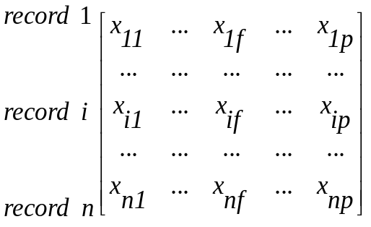
Data Types and Distance Metrics
Data Structures
Data Matrix (object-by-variable structure)
  n records, each with p attributes
  n-by-p matrix structure (two mode)
  x_{ab} – value for a^{th} record and b^{th} attribute
        Attributes
Notes:
Data Matrix – Examples of attributes are age, gender, race etc

Slide 11

Data Types and Distance Metrics
Data Structures
Dissimilarity Matrix (object-by-object structure)
  n-by-n table (one mode)
  d(i,j) is the measured difference or dissimilarity between record i and j

Slide 12
Data Types and Distance Metrics
Interval-Scaled Attributes
Binary Attributes
Nominal Attributes
Ordinal Attributes
Ratio-Scaled Attributes
Attributes of Mixed Type

Slide 13
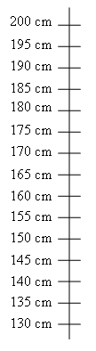
Data Types and Distance Metrics
Interval-Scaled Attributes
Continuous measurements on a roughly linear scale
Example
Height Scale | Weight Scale
1. Scale ranges over the metre or foot scale 2. Need to standardize heights as different scale can be used to express same absolute measurement | 1. Scale ranges over the kilogram or pound scale
40kg
80kg
120kg
20kg
60kg
100kg

Slide 14
Data Types and Distance Metrics
Interval-Scaled Attributes
Using Interval-Scaled Values
  Step 1: Standardize the data
    To ensure they all have equal weight
    To match up different scales into a uniform, single scale
    Not always needed! Sometimes we require unequal weights for an attribute
  Step 2: Compute dissimilarity between records
    Use Euclidean, Manhattan or Minkowski distance
Notes:
Why should we standardize the data of all the attributes?
1a. To ensure that they all have equal weight.
1b. Expressing a variable in smaller units will lead to a larger range for that variable, and thus a larger effect on the resulting clustering structure
How do you standardise the data?
Mean absolute deviation,

Slide 15

Data Types and Distance Metrics
Interval-Scaled Attributes
Minkowski distance
Euclidean distance
  q = 2
Manhattan distance
  q = 1
What are the shapes of these clusters?
  Spherical in shape.
Notes:
Ans. The clusters are usually spherical with about the same density and size (E and Man distances)
The reason is that a bunch of objects which are clustered together can be thought to be averaged out at a point and that point is the center of the sphere/circle

Slide 16
Data Types and Distance Metrics
Interval-Scaled Attributes
Properties of d(i,j)
  d(i,j) >= 0: Distance is non-negative. Why?
  d(i,i) = 0: Distance of an object to itself is 0. Why?
  d(i,j) = d(j,i): Symmetric. Why?
  d(i,j) <= d(i,h) + d(h,j): Triangle Inequality rule
Weighted distance calculation also simple to compute

Slide 17
Data Types and Distance Metrics
Binary Attributes
Has only two states – 0 or 1
Compute dissimilarity between records (equal weightage)
  Contingency Table
  Symmetric Values: A binary attribute is symmetric if the outcomes are both equally important
  Asymmetric Values: A binary attribute is asymmetric if the outcomes of the states are not equally important
 |  | Object j
 |  | 1 | 0
Object i | 1 | a | b
 | 0 | c | d
Notes:
Example for Symmetric and Asymmetric variables
1. One example for symmetric variables is gender – male or female
2. A test that tells you whether you have a particular disease has two outcomes. A positive which means you do and a negative which means you don’t. If we take the positive to be 1 and the negative 0 (because positive is the rarer case) then two variables having 1s are more significant than two variables having 0s.

Slide 18
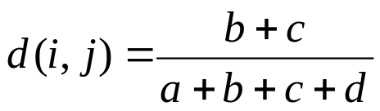
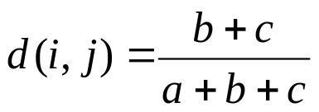
Data Types and Distance Metrics
Binary Attributes
  Simple matching coefficient (Symmetric)
  Jaccard coefficient (Asymmetric)

Slide 19
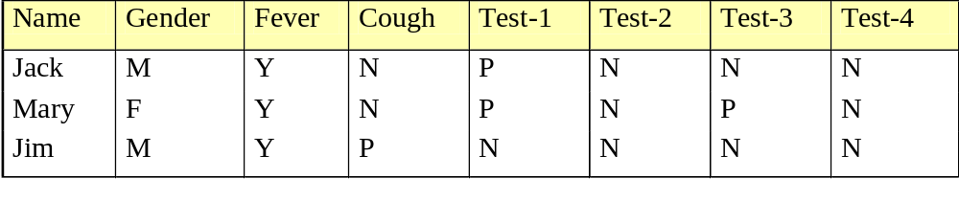

Data Types and Distance Metrics
Ex:
  Gender attribute is symmetric
  All others aren’t. If Y and P are 1 and N is 0, then
Cluster Analysis By: Arthy Krishnamurthy & Jing Tun, Spring 2005

Slide 20
Data Types and Distance Metrics
Nominal Attributes
Extension of a binary attribute – can have more than two states
Ex: figure_colour is a attribute which has, say, 4 values: yellow, green, red and blue
Let number of values be M
Compute dissimilarity between two records i and j
  d(i,j) = (p – m) / p
  m -> number of attributes for which i and j have the same value
  p -> total number of attributes
Notes:
Nominal values are an extension or generalisation of a binary variable

Slide 21
Nominal Attributes
Can be encoded by using asymmetric binary attributes for each of the M values
For a record with a given value, the binary attribute value representing that value is set to 1, while the remaining binary values are set to 0
Ex:
 | Yellow | Green | Red | Blue
Record 1 | 0 | 0 | 1 | 0
Record 2 | 0 | 1 | 0 | 0
Record 3 | 1 | 0 | 0 | 0
Object 1
Object 2
Object 3

Slide 22
Data Types and Distance Metrics
Ordinal Attributes
Discrete Ordinal Attributes
  Nominal attributes with values arranged in a meaningful manner
Continuous Ordinal Attributes
  Continuous data on unknown scale. Ex: the order of ranking in a sport (gold, silver, bronze) is more essential than their values
  Relative ranking
Used to record subjective assessment of certain characteristics which cannot be measured objectively
Notes:
Examples of discrete ordinal variables are ranks in class, or rank in the army.

Slide 23
Data Types and Distance Metrics
Ordinal Attributes
Compute dissimilarity between records
  Step 1: Replace each value by its corresponding rank
    Ex: Gold, Silver, Bronze with 1, 2, 3
  Step 2: Map the range of each variable onto [0.0,1.0]
    If the rank of the i_{th} object in the f_{th} ordinal variable is r_{if}, then replace the rank with z_{if} = (r_{if} – 1) / (M_{f} – 1) where M_{f} is the total number of states of the ordinal variable f
  Step 3: Use distance methods for interval-scaled attributes to compute the dissimilarity between objects

Slide 24
Data Types and Distance Metrics
Ratio-Scaled Attributes
Makes a positive measurement on a non-linear scale
Compute dissimilarity between records
  Treat them like interval-scaled attributes. Not a good choice since scale might be distorted
  Apply logarithmic transformation and then use interval-scaled methods.
  Treat the values as continuous ordinal data and their ranks as interval-based
Notes:
1. Example, it follows the formula Ae^{Bt} or Ae^{-Bt}
2. Ratio-scaled variable f having value x_{if} for object i by using the formula y_{if} = log(x_{if})

Slide 25
Data Types and Distance Metrics
Attributes of mixed types
Real databases usually contain a number of different types of attributes
Compute dissimilarity between records
  Method 1: Group each type of attribute together and then perform separate cluster analysis on each type. Doesn’t generate compatible results
  Method 2: Process all types of attributes by using a weighted formula to combine all their effects.
Notes:
Pg 346 of the textbook

Slide 26
Overview
What is Clustering/Cluster Analysis?
Applications of Clustering
Data Types and Distance Metrics
Major Clustering Methods

Slide 27
Clustering Methods
Partitioning methods
Hierarchical methods
Density-based methods
Grid-based methods
Model-based methods
Choice of algorithm depends on type of data available and the nature and purpose of the application

Slide 28
Clustering Methods
Partitioning methods
  Divide the objects into a set of partitions based on some criteria
  Improve the partitions by shifting objects between them for higher intraclass similarity, interclass dissimilarity and other such criteria
  Two popular heuristic methods
    k-means algorithm
    k-medoids algorithm
Notes:
The K-means algorithm assigns each point to the cluster whose center (also called centroid) is nearest. The center is the average of all the points in the cluster — that is, its coordinates are the arithmetic mean for each dimension separately over all the points in the cluster.

Slide 29
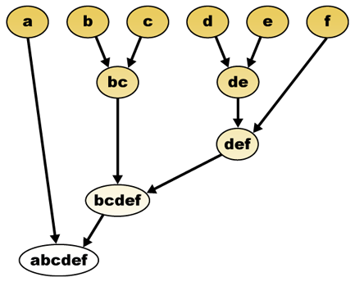
Clustering Methods
Hierarchical methods
  Build up or break down groups of objects in a recursive manner
  Two main approaches
    Agglomerative approach
    Divisive approach
© Wikipedia

Slide 30
Clustering Methods
Density-based methods
  Grow a given cluster until the density decreases below a certain threshold
Grid-based methods
  Form a grid structure by quantizing the object space into a finite number of grid cells
Model-based methods
  Hypothesize a model and find the best fit of the data to the chosen model

Slide 31
Constrained K-means Clustering with Background Knowledge
K. Wagsta, C. Cardie, S. Rogers, & S. Schroedl
Proceedings of 18th
International Conference on Machine Learning
2001. (pp. 577-584).
Morgan Kaufmann, San Francisco, CA.

Slide 32
Introduction
Clustering is an unsupervised method of data analysis
Data instances grouped according to some notion of similarity
  Multi-attribute based distance function
  Access to only the set of features describing each object
  No information as to where each instance should be placed with partition
However there might be background knowledge about the domain or data set that could be useful to algorithm
In this paper the authors try to integrate this background knowledge into clustering algorithms.
Notes:
As we saw in the previous slides clustering is an unsupervised method of data analysis. The various clustering analysis mentioned group data instances according to some notion of similarity. Similarity between two instances is usually quantified using some function which takes as input the values of attributes describing each object. For example if we to partition or cluster students in this class based on age, gender and nationality we could devise a function which puts two students in the same group if they were born within 12 months of each other and in the same country. This function would produce a distance and based on that value the algorithm will make a decision as to whether the two students should be in the same group or different groups. If the distance is small the students will be in the same group.
However it is often the case that the implementer possesses some background knowledge about the domain or the data set that could be useful in clustering the data. For instance you might have some partially labeled data, training set. In this paper the authors are using gps data to refine road maps to the lane level. So in this domain they have access to some background knowledge, e.g. a constraint can be that if two points are separated by more than 4 meters they can belong to the same lane and cannot be in the same group.
Traditionally clustering algorithms have no way to take advantage of this information even when it does exist. This paper tries to integrate background information into clustering algorithms.
There might be a question here about why can’t this background information be encapsulated as a attribute?
I have the same question maybe the professor could explain ☺. One possible explanation the papers hints at is that this is information about the domain and not specific to any one data instance and thus cannot be made an attribute value. It is knowledge about why two instance should or should not be grouped together.

Slide 33
K-Means Clustering Algorithm
K-Means algorithm is a type of partitioning method
Group instances based on attributes into k groups
  High intra-cluster similarity; Low inter-cluster similarity
  Cluster similarity is measured in regards to the mean value of objects in the cluster.
How does K-means work ?
  First, select K random instances from the data – initial cluster centers
  Second, each instance is assigned to its closest (most similar) cluster center
  Third, each cluster center is updated to the mean of its constituent instances
  Repeat steps two and three till there is no further change in assignment of instances to clusters
How is K selected ?

Slide 34
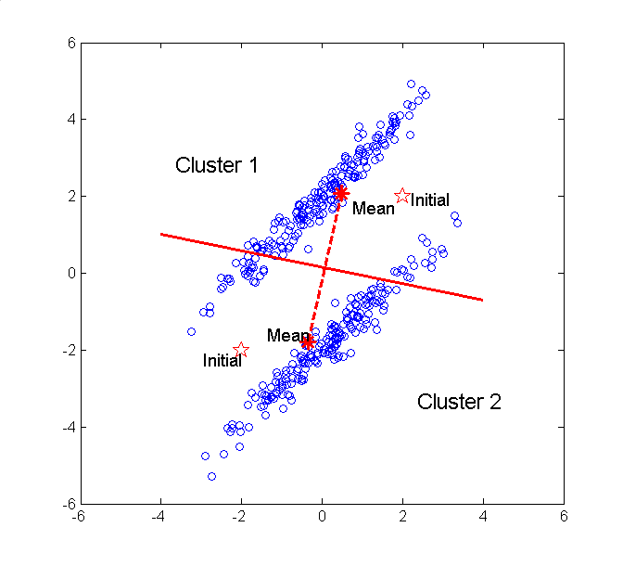
K-Means Clustering Algorithm

Slide 35
Constrained K-Means Clustering
Instance level constraints to express a priori knowledge about the instances which should or should not be grouped together
Two pair-wise constraints
  Must-link: constraints which specify that two instances have to be in the same cluster
  Cannot-link: constraints which specify that two instances must not be placed in the same cluster
  When using a set of constraints we have to take the transitive closure
Constraints may be derived from
  Partially labeled data
  Background knowledge about the domain or data set

Slide 36
Constrained Algorithm
First, select K random instances from the data – initial cluster centers
Second, each instance is assigned to its closest (most similar) cluster center such that VIOLATE-CONSTRAINT(I, K, M, C) is false. If no such cluster exists , fail
Third, each cluster center is updated to the mean of its constituent instances
Repeat steps two and three till there is no further change in assignment of instances to clusters
VIOLATE-CONSTRAINT(instance I, cluster K, must-link constraints M, cannot-link constraints C)
  For each (i, i=) in M: if i= is not in K, return true.
  For each (i, i≠) in C : if i≠ is in K, return true
  Otherwise return false
Notes:
The inputs for the modified algorithm are different, it takes in a data set, a set of must link constraints M, a set of cannot-link constraints C. It returns a partition of the instances of the set that satisfies all specified constraints. The major modification is that, when updating cluster assignments, we ensure that none of the specified constraints are violated. We attempt to assign each point di to its closest cluster Cj .
As with the regular k-means algorithm the modified version starts by selecting k random instances from the data, these become the initial cluster centers.
Second each is instance is assigned to its closest cluster center as long as a constraint is not violated. If there is another point d= that must be assigned to the same cluster as d, but that is already in some other cluster, or there is another point d= that cannot be grouped with d but is already in C, then d cannot be placed in C.
The algorithm continues down the sorted list of clusters until we find one that can legally host d. Constraints are never broken; if a legal cluster cannot be found for d, the empty partition ({}) is returned.

Slide 37
Experimental Results on
GPS Lane Finding
Large database of digital road maps available
  These maps contain only coarse information about the location of the road
  By refining maps down to the lane level we can enable a host of more sophisticated applications such as lane departure detection
Collect data about the location of cars as they drive along a given road
  Collect data once per second from several drivers using GPS receivers affixed to top of their vehicles
  Each data instance has two features: 1. Distance along the road segment and 2. Perpendicular offset from the road centerline
  For evaluation purposes drivers were asked to indicate which lane they occupied and any lane changes
Notes:
The authors tested the modified algorithm on a variety of different data sets. The constraints were generated as follows: for each constraint, we randomly picked two instances from the data set and checked their labels (which are available for evaluation purposes but not visible to the clustering algorithm). If they had the same label, we generated a must-link constraint. Otherwise, we generated a cannot-link constraint.
THE CONSTRAINTS WERE RANDOMLY GENERATED FROM TRUE DATA LABELS
To demonstrate the utility of constrained clustering with real domain knowledge, they applied the modified k-means to the problem of lane finding in GPS data.

Slide 38
GPS Lane Finding
Cluster data to automatically determine where the individual lanes are located
  Based on the observation that drivers tend to drive within lane boundaries.
  Domain specific heuristics for generating constraints.
    Trace contiguity means that, in the absence of lane changes, all of the points generated from the same vehicle in a single pass over a road segment should end up in the same lane.
    Maximum separation refers to a limit on how far apart two points can be (perpendicular to the centerline) while still being in the same lane. If two points are separated by at least four meters, then we generate a constraint that will prevent those two points from being placed in the same cluster.
To better suit domain cluster center representation had to be changed.
Notes:
“Based on the observation that drivers tend to drive within lane boundaries “ -- These were obviously not long island drivers
To better analyze performance in this domain, the authors modified the cluster center representation. The usual
way to compute the center of a cluster is to average all of its constituent points. There are two significant drawbacks of this representation. First, the center of a lane is a point halfway along its extent, which commonly means that points inside the lane but at the far ends of the road appear to be extremely far from the cluster center. Second, applications that make use of the clustering results need more than a single point to define a lane.
Consequently, we instead represented each lane cluster with a line segment parallel to the centerline. This more accurately models what we conceptualize as “the center of the lane", provides a better basis for measuring the distance from a point to its lane cluster center, and provides useful output for other applications.

Slide 39
Performance
Segment (size) | K-means | COP-Kmeans | Constraints Alone
1 (699) | 49.8 | 100 | 36.8
2 (116) | 47.2 | 100 | 31.5
3 (521) | 56.5 | 100 | 44.2
4 (526) | 49.4 | 100 | 47.1
5 (426) | 50.2 | 100 | 29.6
6 (502) | 75.0 | 100 | 56.3
7 (623) | 73.5 | 100 | 57.8
8 (149) | 74.7 | 100 | 53.6
9 (496) | 58.6 | 100 | 46.8
10 (634) | 50.2 | 100 | 63.4
11 (1160) | 56.5 | 100 | 72.3
12 (427) | 48.8 | 96.6 | 59.2
13 (587) | 69.0 | 100 | 51.5
14 (678) | 65.9 | 100 | 59.9
15 (400) | 58.8 | 100 | 39.7
16 (115) | 64.0 | 76.6 | 52.4
17 (383) | 60.8 | 98.9 | 51.4
18 (786) | 50.2 | 100 | 73.7
19 (880) | 50.4 | 100 | 42.1
20 (570) | 50.1 | 100 | 38.3
Average | 58.0 | 98.6 | 50.4
Notes:
The modified algorithm (third column) consistently outperformed the unconstrained k-means algorithm (first column), attaining 100% accuracy for all but three data sets and averaging 98.6% overall.
The unconstrained version of k-means performed much worse, averaging 58.0% accuracy.
The final column in Table 2 is a measure of how much is known after generating the constraints and before doing any clustering. It shows that an average accuracy of 50.4% can be achieved using the background information alone.
What this demonstrates is that neither general similarity information (k-means clustering) nor domain-specific information (constraints)
alone perform very well, but that combining the two sources of information effectively can produce excellent results.

Slide 40
Conclusion
Measurable improvement in accuracy
The use of constraints while clustering means that, unlike the regular k-means algorithm, the assignment of instances to clusters can be order-sensitive.
  If a poor decision is made early on, the algorithm may later encounter an instance i that has no possible valid cluster
  Ideally, the algorithm would be able to backtrack, rearranging some of the instances so that i could then be validly assigned to a cluster.
Could be extended to hierarchical algorithms
Notes:
(e.g., it has a cannot-link constraint to at least one item in each of the k clusters). This occasionally occurred in our experiments (for some of the random data orderings).

Slide 41
CSE 634
Data Mining Concepts & Techniques
Professor Anita Wasilewska
Stony Brook University
Ligand Pose Clustering

Slide 42
Abstract
Detailed atomic-level structural and energetic information from computer calculations is important for understanding how compounds interact with a given target and for the discovery and design of new drugs. Computational high-throughput screening (docking) provides an efficient and practical means with which to screen candidate compounds prior to experiment. Current scoring functions for docking use traditional Molecular Mechanics (MM) terms (Van der Waals and Electrostatics).
To develop and test new scoring functions that include ligand desolvation (MM-GBSA), we are building a docking test set focused on medicinal chemistry targets. Docked complexes are rescored on the receptor coordinates, clustered into diverse binding poses and the top five representative poses are reported for analysis. Known receptor-ligand complexes are retrieved from the protein databank and are used to identify novel receptor-ligand complexes of potential drug leads.

Slide 43
References
Kuntz, I. D. (1992). "Structure-based strategies for drug design and discovery." Science 257(5073): 1078-1082.
Nissink, J. W. M., C. Murray, et al. (2002). "A new test set for validating predictions of protein-ligand interaction." Proteins-Structure Function and Genetics 49(4): 457-471.
Mozziconacci, J. C., E. Arnoult, et al. (2005). "Optimization and validation of a docking-scoring protocol; Application to virtual screening for COX-2 inhibitors." Journal of Medicinal Chemistry 48(4): 1055-1068.
Mohan, V., A. C. Gibbs, et al. (2005). "Docking: Successes and challenges." Current Pharmaceutical Design 11(3): 323-333.
Hu, L. G., M. L. Benson, et al. (2005). "Binding MOAD (Mother of All Databases)." Proteins-Structure Function and Bioinformatics 60(3): 333-340.

Slide 44
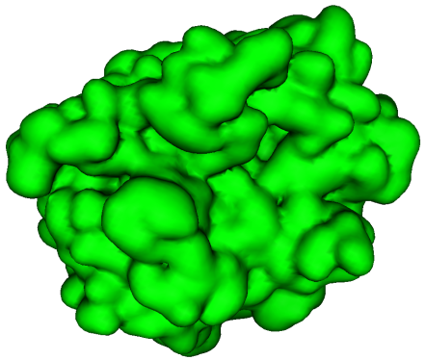
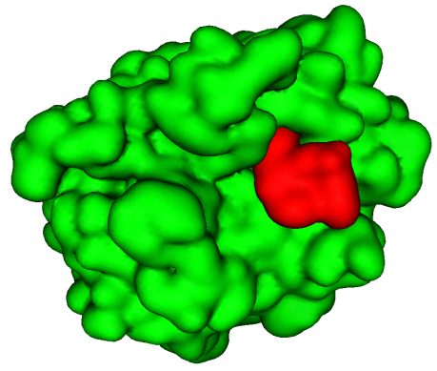
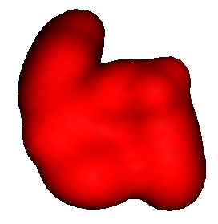
Docking
Computational search for the most energetically favorable binding pose of a ligand with a receptor.
  Ligand → small organic molecules
  Receptor → proteins, nucleic acids
Receptor: Trypsin
Ligand: Benzamidine
Complex

Slide 45
Receptor - Ligand
Complex Crystal Structure
Ligand
Receptor
dms
Inspection
Leap
Sander
Convert
mbondi
radii
Disulfide
bonds
Add hydrogens
Molecular
Surface
Processed
Ligand
sphgen
mol2 receptor
Docking Spheres
Gaussian
6-12 LJ GRID
ab initio
charges
keep max 75 within
spheres 8A
Receptor grid
mol2 ligand
Active site spheres
DOCK
Docked
Receptor – Ligand Complex

Slide 46
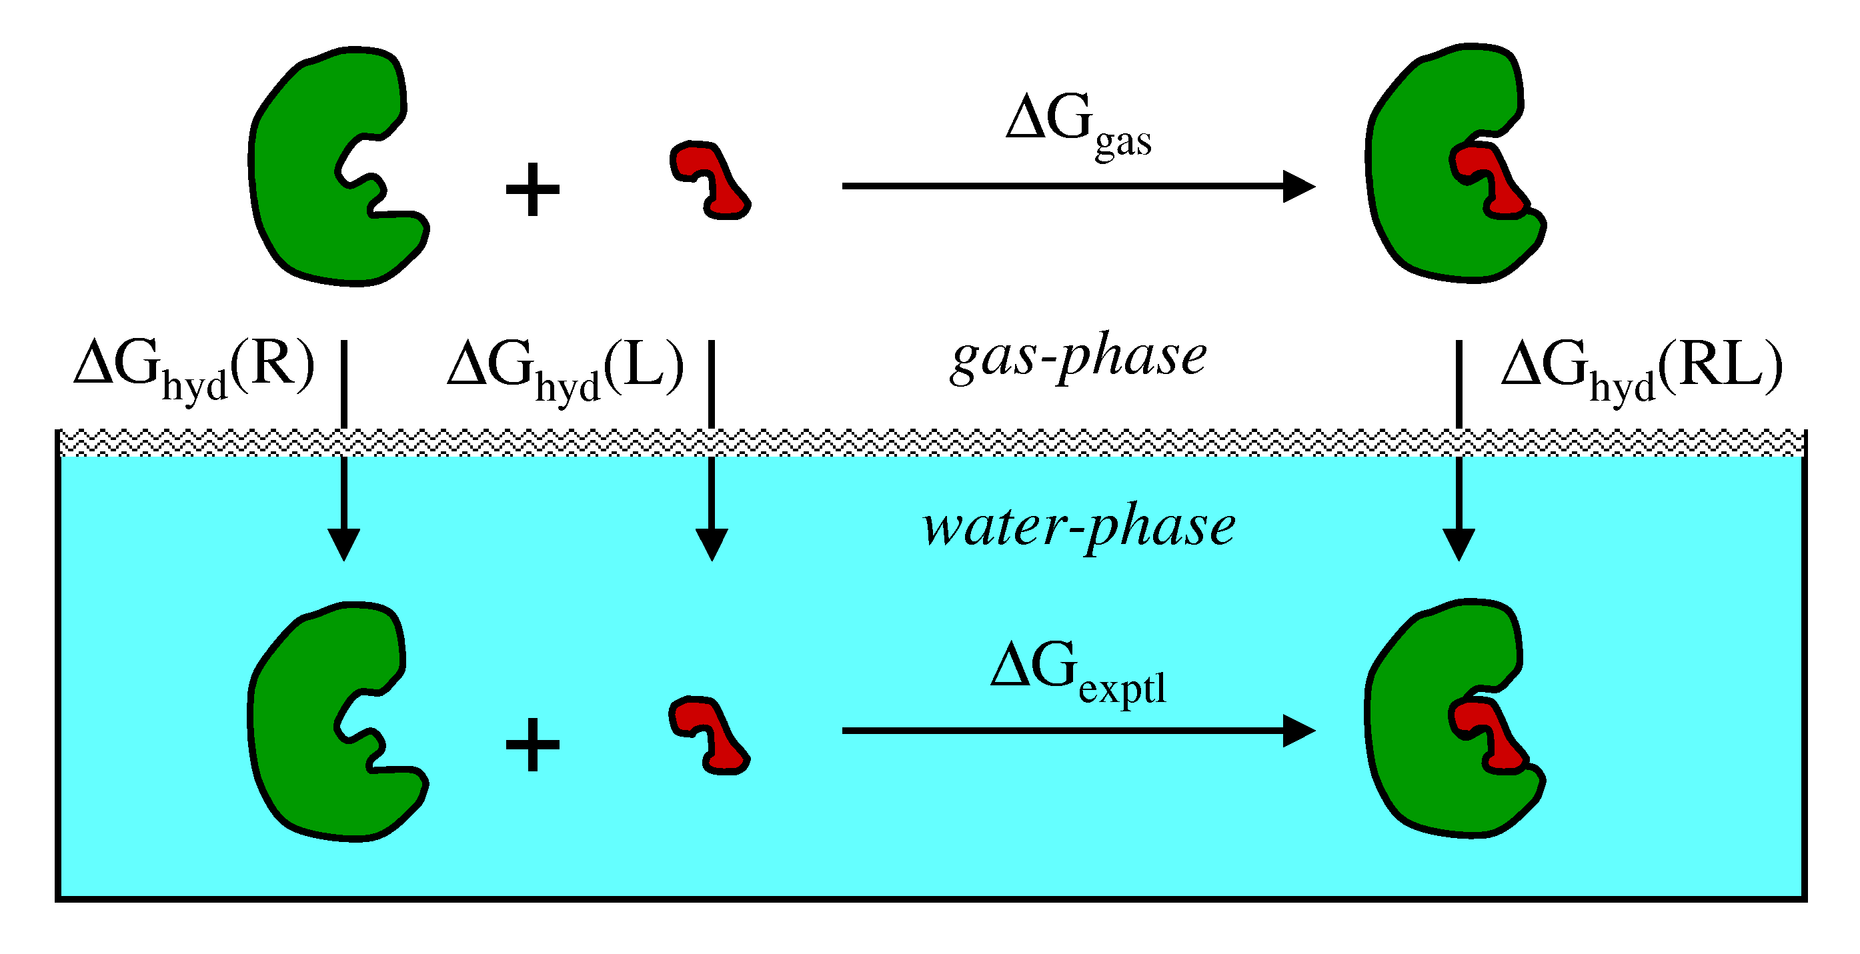
Improved Scoring Function (MM-GBSA)
R = receptor, L = ligand, RL = receptor-ligand complex
- MM (molecular mechanics: VDW + Coul)
- GB (Generalized Born)
- SA (Solvent Accessible Surface Area)
*Srinivasan, J. ; et al. J. Am. Chem. Soc. 1998, 120, 9401-9409
Notes:
To study the binding and selectivity of the thidiazoles with MMPS we used a relatively new method to quantify molecular recognition termed MM-GBSA that was championed by researchers in Peter Kollman's group at UCSF and David Case's group at Scripps. This method aims to include important desolvation effects that are expected to be be particularly important for our simulations given the fact that the MMPs contain several Calcium and two Zinc ions. In MM-GBSA a thermodynamic cycle is employed to represent the molecular recognition event. Experimental binding energies measured in the condensed-phase are related to the sum of energetic contributions computed from gas-phase interaction energies and free energy of hydration calculations to account for desolvation. Whereas the extended linear response method approaches ligand binding from the point of view of the ligand and its different environment, the MM-GBSA methods take a different approach and include calculations that consider changes in the total system not only the ligand.

Slide 47
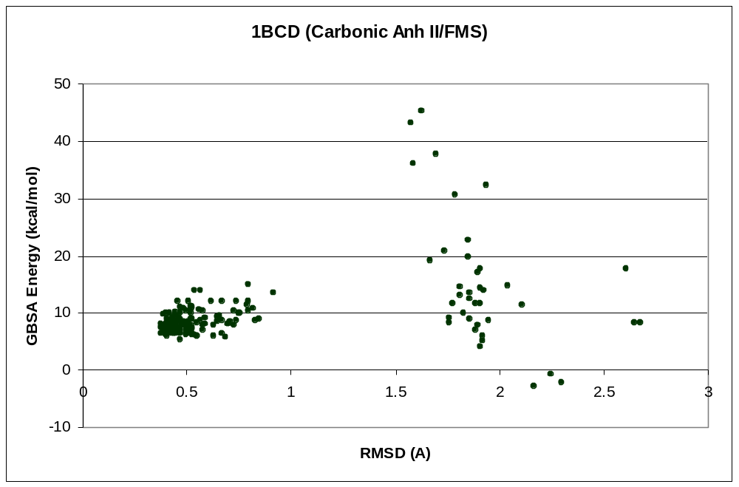
Clustering Methods used
Initially, we clustered on a single dimension, i.e. RMSD. All ligand poses within 2A RMSD of each other were retained.
Better results were obtained using agglomerative clustering using the R statistical package.
RMSD clustering
Agglomerative
clustering

Slide 48
Agglomerative Clustering
Agglomerative Clustering, each object is initially placed into its own group. A threshold distance is selected.
Compare all pairs of groups and mark the pair that is closest.
The distance between this closest pair of groups is compared to the threshold value.
  If (distance between this closest pair <= threshold distance) then merge groups. Repeat.
  Else If (distance between the closest pair > threshold)
  then (clustering is done)

Slide 49

R Project for Statistical Computing
R is a free software environment for statistical computing and graphics.
Available at http://www.r-project.org/
Developed by Statistics Department, University of Auckland
R 2.2.1 is used in my research
plotacpclust = function(data,xax=1,yax=2,hcut,cor=TRUE,clustermethod="ave",colbacktitle="#e8c9c1",wcos=3,Rpowered=FALSE,...)
{ # data: data.frame to analyze
# xax, yax: Factors to select for graphs
# Parameters for hclust # hcut # clustermethod require(ade4)
pcr=princomp(data,cor=cor) datac=t((t(data)-pcr$center )/pcr$scale) hc=hclust(dist(data),method=clustermethod) if (missing(hcut)) hcut=quantile(hc$height,c(0.97)) def.par <- par(no.readonly = TRUE) on.exit(par(def.par)) mylayout=layout(matrix(c(1,2,3,4,5,1,2,3,4,6,7,7,7,8,9,7,7,7,10,11),ncol=4),widths=c(4/18,2/18,6/18,6/18),heights=c(lcm(1),3/6,1/6,lcm(1),1/3)) par(mar = c(0.1, 0.1, 0.1, 0.1)) par(oma = rep(1,4)) ltitle(paste("PCA ",dim(unclass(pcr$loadings))[2], "vars"),cex=1.6,ypos=0.7) text(x=0,y=0.2,pos=4,cex=1,labels=deparse(pcr$call),col="black") pcl=unclass(pcr$loadings) pclperc=100*(pcr$sdev)/sum(pcr$sdev) s.corcircle(pcl[,c(xax,yax)],1,2,sub=paste("(",xax,"-",yax,") ",round(sum(pclperc[c(xax,yax)]),0),"%",sep=""),possub="bottomright",csub=3,clabel=2) wsel=c(xax,yax) scatterutil.eigen(pcr$sdev,wsel=wsel,sub="")

Slide 50
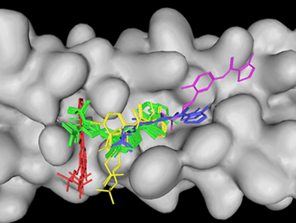
Clustered Poses
Peptide ligand bound to GP-41 receptor

Slide 51
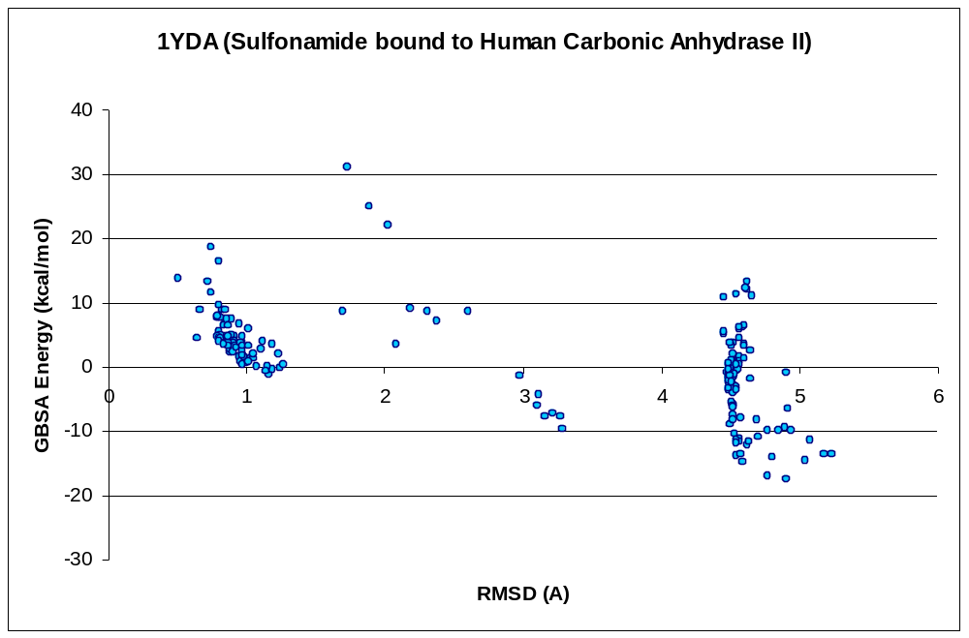
RMSD vs. Energy Score Plots

Slide 52
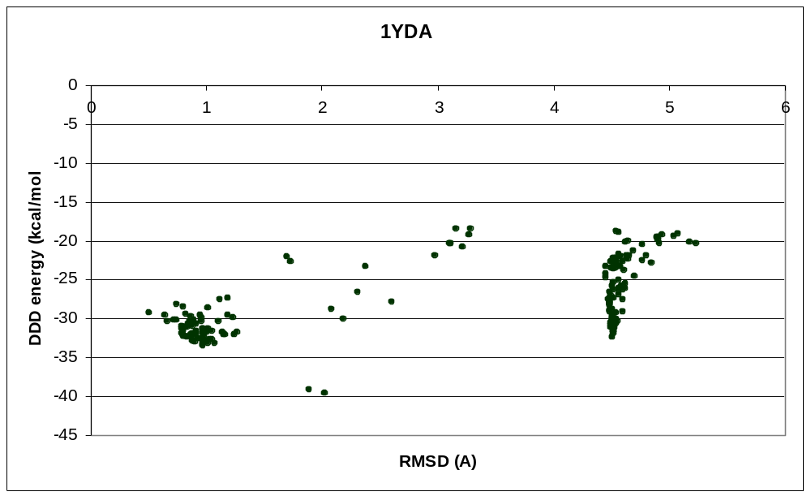
RMSD vs. Energy Score Plots

Slide 53
RMSD vs. Energy Score Plots

Slide 54
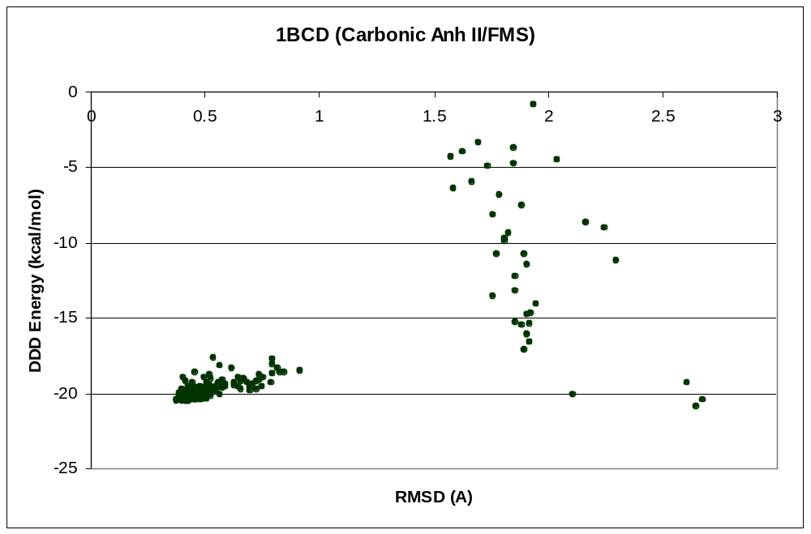
RMSD vs. Energy Score Plots

Slide 55
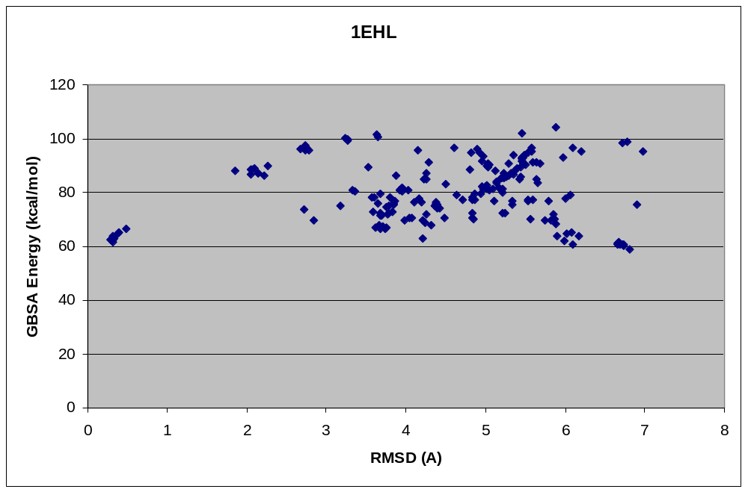
RMSD vs. Energy Score Plots

Slide 56
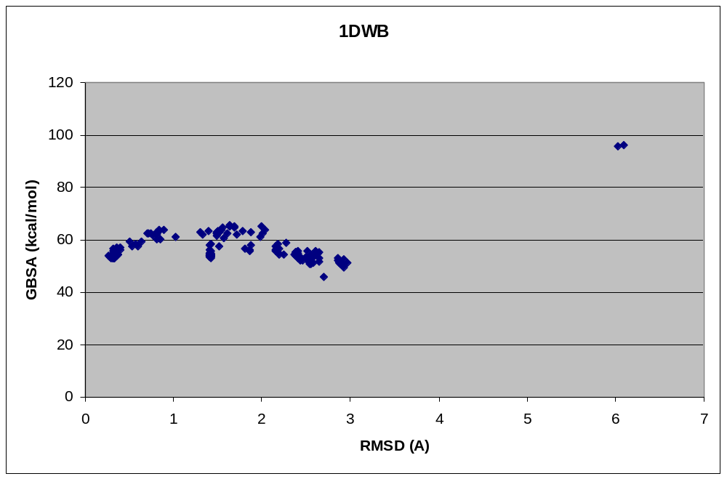
RMSD vs. Energy Score Plots

Slide 57
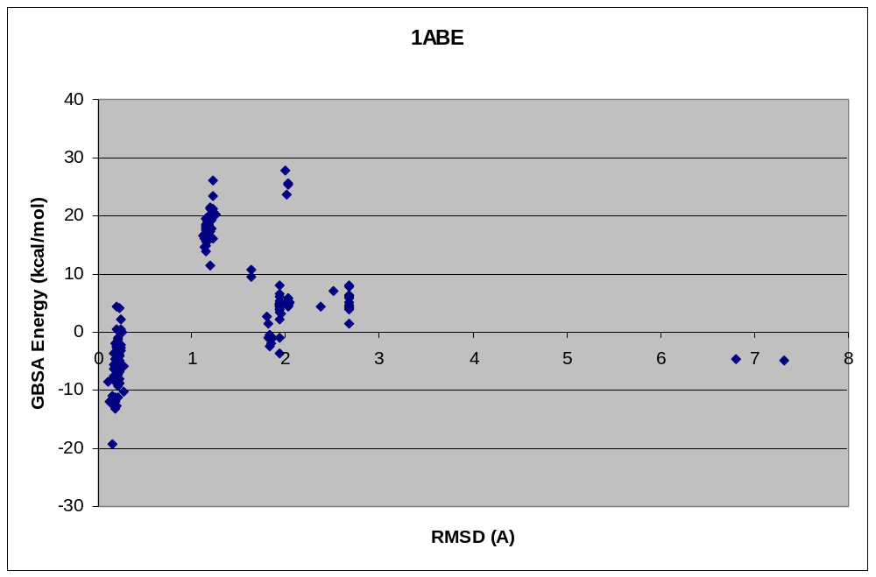
RMSD vs. Energy Score Plots

Slide 58
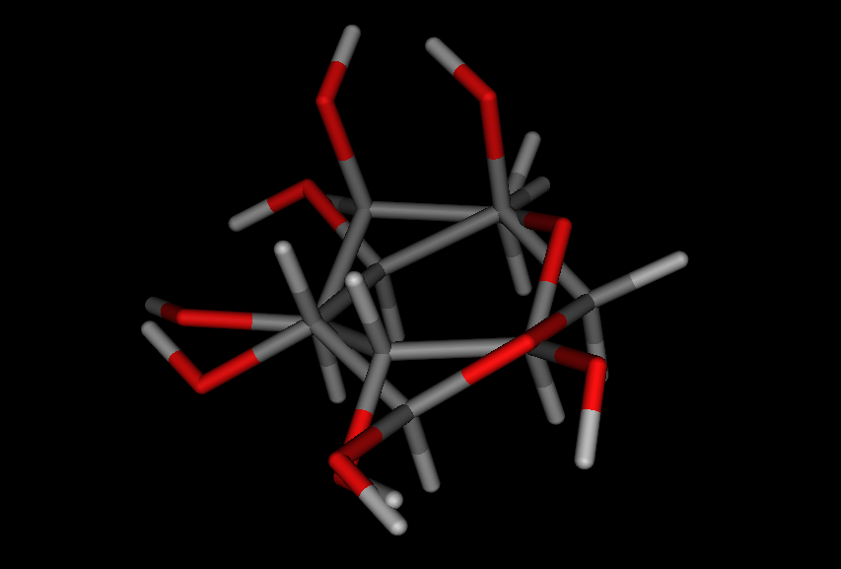
1ABE Clustered Poses

Slide 59
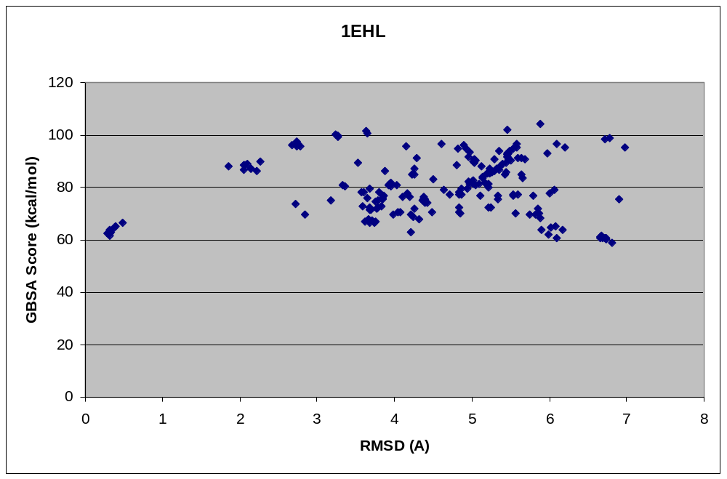
RMSD vs. Energy Score Plots

Slide 60
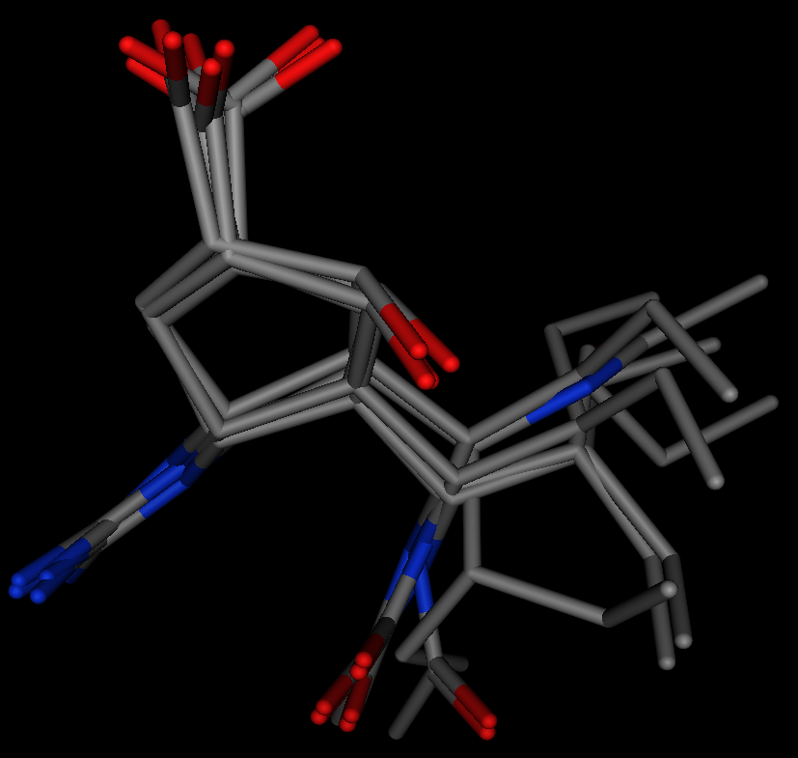
Peramivir clustered poses

Slide 61
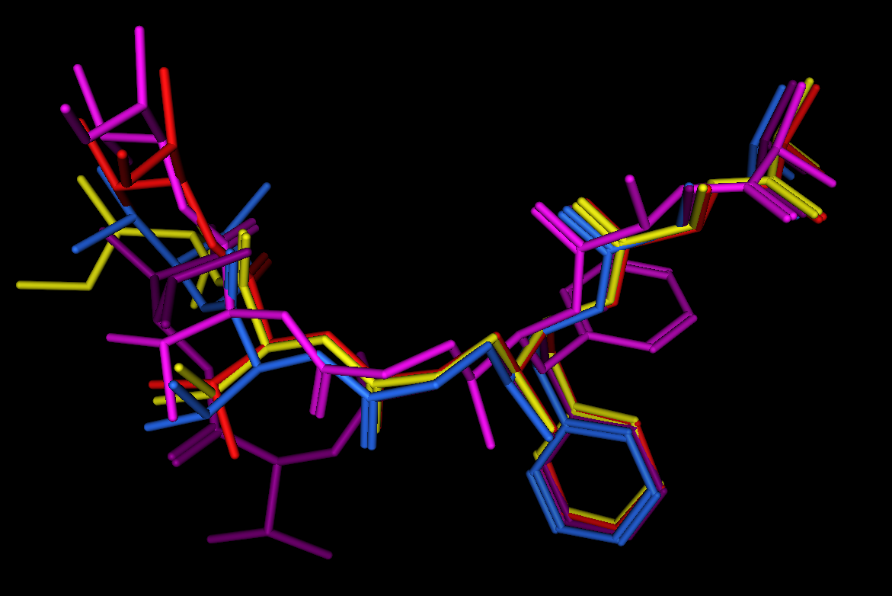
Peptide mimetic inhibitor HIV-1 Protease

